Slide 2
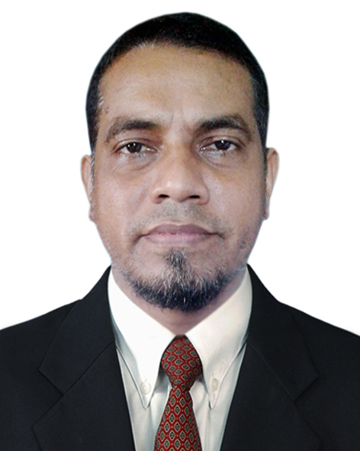
Teacher’s Introduction
Mohammad Kamal Uddin
Assistant Headmaster Chandranath Girls’ High School,
Chhatak, Sunamganj

Slide 3
English For Today
Class – IX-X
Unit – 12
Lesson – 03
The return of the native

Slide 4
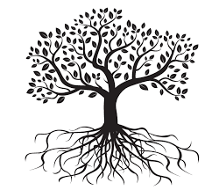
Look at the picture
What do you see in the picture?

Slide 5
Learning Outcome
By the end of the lesson the learners will be able to
exchange personal information
narrate incidents and events in a logical sequence
present information in a chart

Slide 6
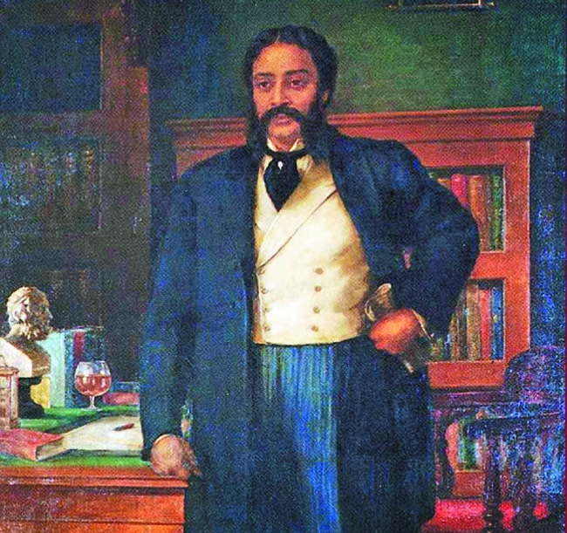
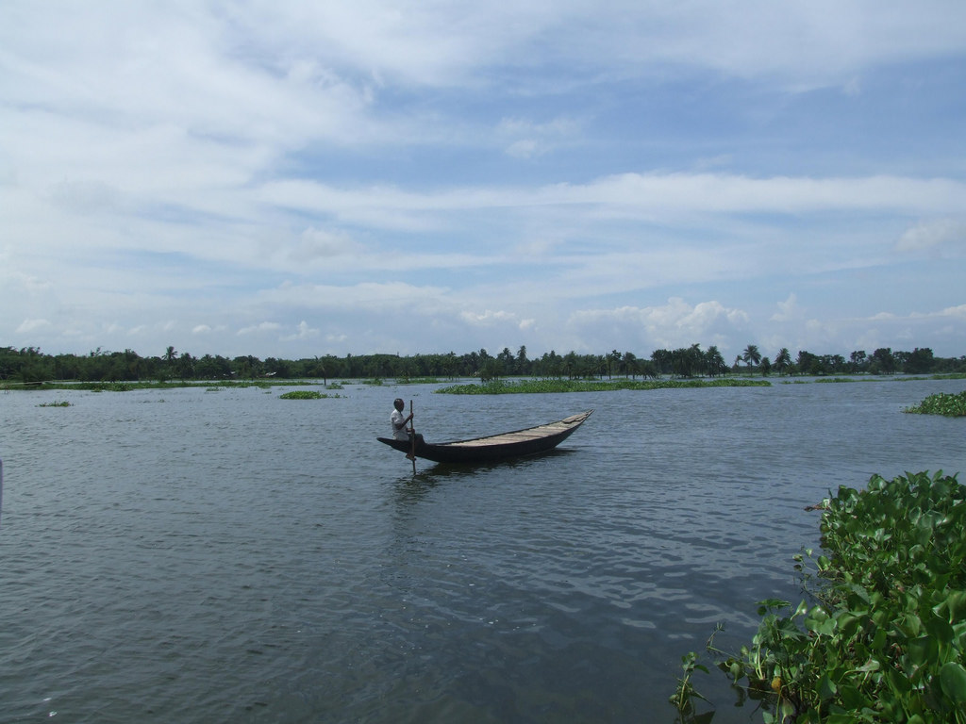
Look at the picture
What do you see in the pictures?
Kopotaksha Nad

Slide 7
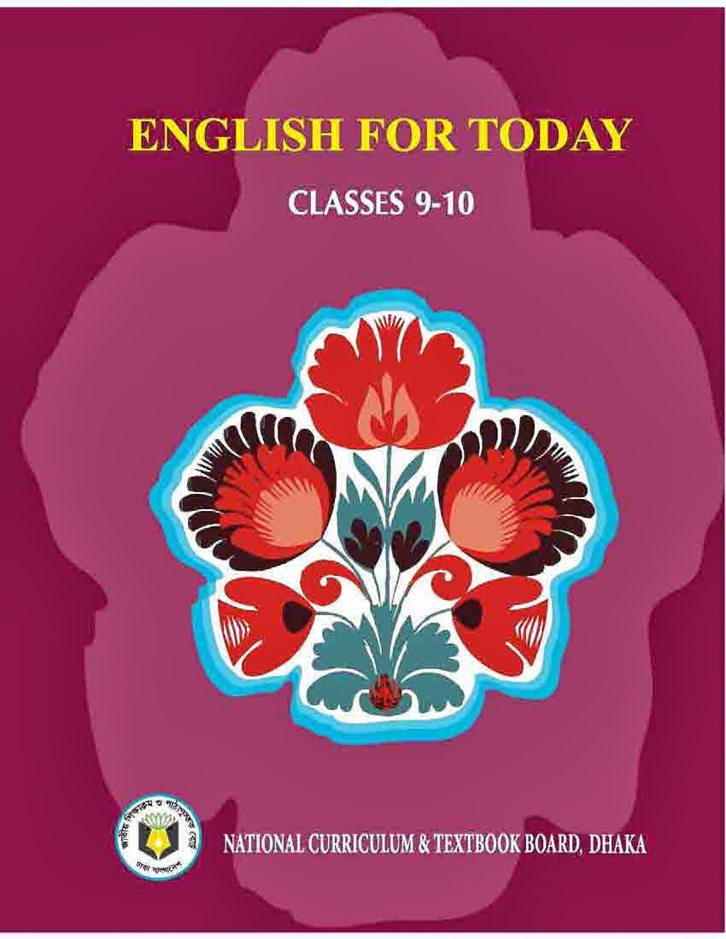
A. Open your book and read the passage

Slide 8
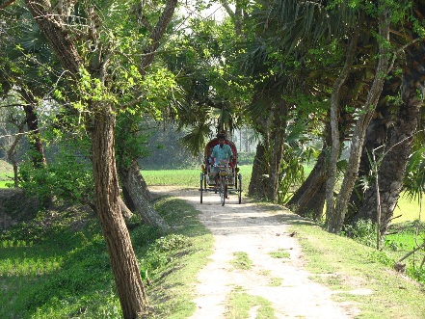
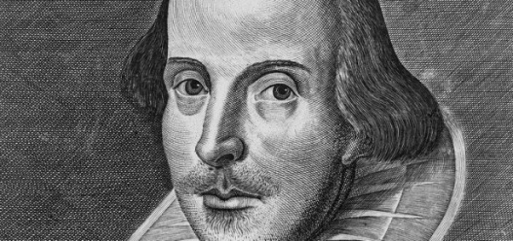
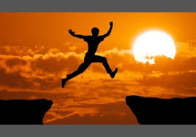
New Vocabulary
Native
inborn
Dramatist
playwright
Aspire
desire

Slide 9
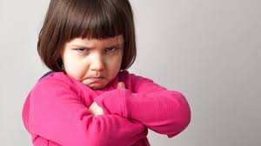
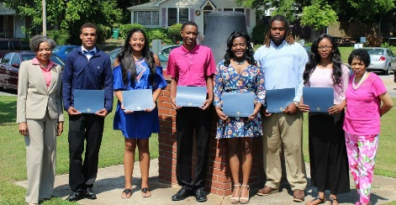
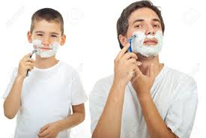
Ire
anger
Recognized
acknowledgement
Imitate
copy

Slide 10
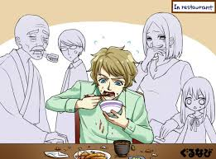
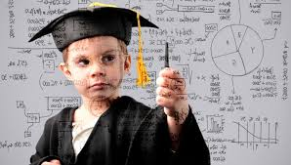
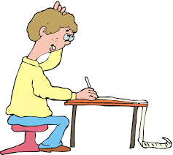
manner
genre
Genius
talent
Compose
write

Slide 11
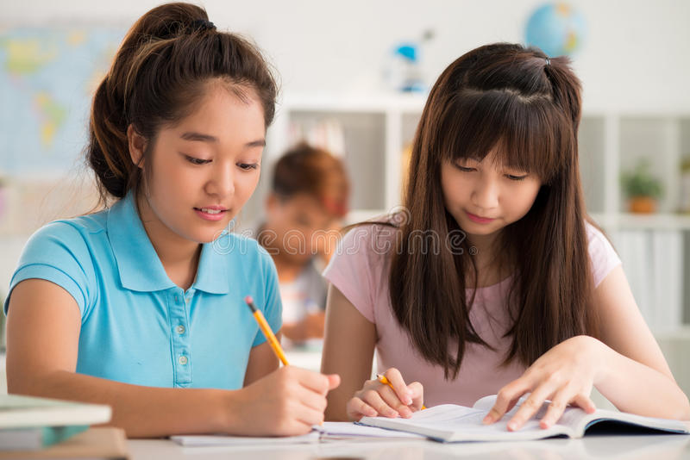
B. Work in pairs and decide how the story of michael is related to the unit theme Roots.
Q: Have you read the text about Michael Madhusudan Dutt?
Q: Where did he go refusing his roots?

Slide 12
C. Read some more information on Michael. Make questions for those statements.
a. What did he introduce in Bangla literature?
He introduced amitrakshar chhanda (blank verse) to Bangla Literature.
b. Where did he pass most of his European days?
Michael passed most of his European days in Versailles, France.
c. How were his days in Europe?
His days in Europe were terrible.

Slide 13
d. Why was it unbearable to him?
It was unbearable to him as he had to suffer extreme poverty.
e. Who helped him to pay off his debts and return to India?
It was Iswar Chandra bidyasagar who helped him to pay off his debts and return to India.
f. How many times did he marry and whom did he marry in Madras?
Dutt married twice. While living in Madras, he married Rebecca McTavish, of English descent.
g. Whom did he marry later/for 2nd time?
Later he married Henrietta Sophia White, who was also ethnic English.

Slide 14
h. How long did his second marriage last?
His second marriage lasted until the end of his life.
i. How many children did they have? What are their names?
Michael and Sophia had a son Napoleon and daughter Sharmistha.
j. When and where did he die?
Dutt died in Calcutta General Hospital on 27 June 1873, three days after the death of Henrietta.

Slide 15
D. Write notes about Micheal under the following headings. One is done for you.
Michael as a man | Michael as a post | Attitude to his roots
 | Popular 19th century Bengali poet and dramatist.

Slide 16
D. Answer
Michael as a man | Michael as a post | Attitude to his roots
He had strong will to imitate the English. | Popular 19th century Bengali poet and dramatist. | He could realize that his true identity lies in this Bengal.

Slide 17
Evaluation
Michael Madhusudan Dutt was - person
i) erudite .ii) sophisticated. iii) imaginative. iv) all the options.
b)His village was decide a -.
i) railway station. Ii) brook. Iii) hill. Iv) none of the options.
c) He aspired to be- from his childhood.
i) a pure Muslim. ii) an ideal Bangali. iii) an English man. Iv) a Christan.
d) His family – him to do whatever he liked
i) supported. ii) disapproved. iii) approved. Iv) helped
e) – recognized him as a hidden talent.
i) His family members. ii) His teachers. iii) His friends. Iv all the options.

Slide 18
Answer
a) (iv) all the options.
b) (ii) brook.
c) (iii) an English man
d) (ii) disapproved.
e) (ii) His teachers

Slide 19
Homework
Summarize the above passage.

